Slide 1
e-Mechanic

Slide 2
Group Members
Usama Latif (BSCS13001)
Zain Amjad (BSCS13041)
Tayeba Tariq (BSCS13058)
Muqaddas Rashid (BSCS13070)

Slide 3
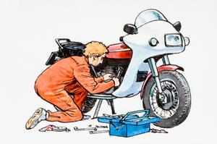
Problem Statement
Most of the people in our country use motor bikes as a mode of transportation so called two-wheelers. As they ride their bikes but most often they do not find time for the maintenance of their bikes which ultimately leads to severe bike issues during travel.

Slide 4
Need Finding Process and Methodology
1- Stakeholders Identification and Analysis
2- Questionnaire Methodology and Forms
3- Field Surveys and Results

Slide 5
1- Stakeholders Identification and Analysis
Motorbike Riders (Potential users)
Mechanics (Potential Users)
Other Mechanics (Competitors)

Slide 6

2- Questionnaire Methodology for Stakeholders
Asked questions like a conversation to develop their trust on us
Asked question individually and in focus groups
Started from General Questions to
Question about themselves

Slide 7


2- Questionnaire Forms for Stakeholders
For Bike Riders
For mechanics
Bike type they use?
After how long they avail services like oil changing and bike tuning?
How much they pay for that?
How do they manage time to get these services?
Their Interaction with smart phone and mobile apps?
Lastly, our idea and feedback on that idea.
Working hours
Days on which they keep their services on?
Their daily earnings (minimum, maximum, average)
Do they provide services to people at home?
Their Interaction with smart phone and mobile apps?

Slide 8
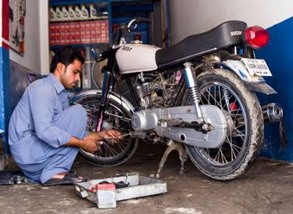
3- Field Surveys
About 20 bike riders and 1 mechanic were interviewed
Interview time was from 20 minutes to 40 minutes
Bike riders were from different communities and classes.

Slide 9
3- Survey Results
1- Which bike do they have?
Their bike models varied form Honda to
Road Prince to
Dhoom and
DYL
2- After how long they take their bikes for tuning and oil changing?
About 40% users responded for “after three months”
About 60% users responded for “after two months”
None of them responded to “after two weeks”

Slide 10
3- Survey Results
3- On asking the reason of such duration,
100% of them responded “Shortage of time”
and zero % responded to others
4- Do they easily find time for oil changing purposes?
68.8% responded to “NO”
31.3% responded to “Yes”

Slide 11
3- Survey Results
5- Interaction with Smart phone and mobile apps
90% of them responded “they use smart phones”
10% responded that “they don’t use smart phones”
Likewise 100% out of 90% responded that they use mobile apps

Slide 12
3- Survey Results
Lastly we asked them about our idea
“If you are given the services of oil changing and
bike tuning at your home on just a single click or
by just a phone call, would you use our service?”
80% responded to “Yes”
20% responded to “No”

Slide 13
Some words from their feedback
“Can't find good mechanics plus over charging”
“time issues”
“It should save my time. And will be hassle free”
“There isn't any particular challenge that I face challenges are different depending on the day on which I go for tuning like some times there is traffic problem and sometimes there are too many customers on the mechanic shop.”
And lastly
“I think the mobile App is good step to improve the bike maintenance system”

Slide 14
Conclusion
We conducted about 20 interviews
After survey we conclude that there is a problem in time for people to maintain their bikes
People want this Project for their bike maintenance
This project can help people to make their life easier
It can make our world a better place

